Slide 1


Slide 2
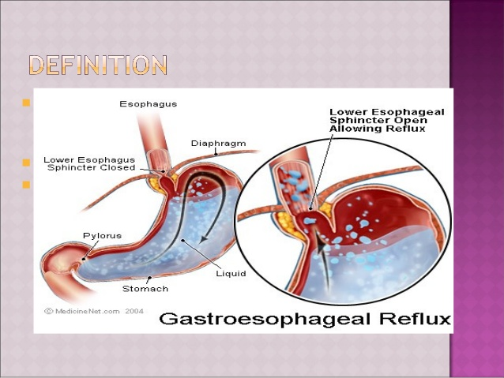

Slide 3
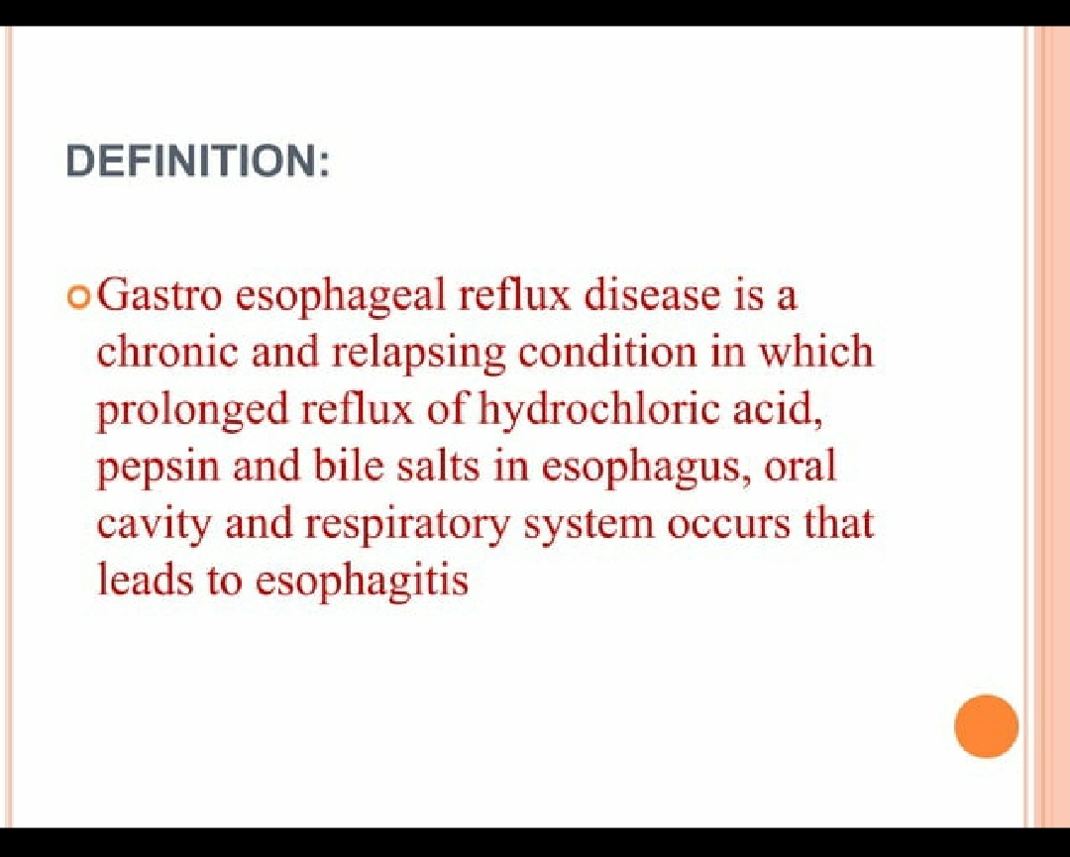

Slide 4
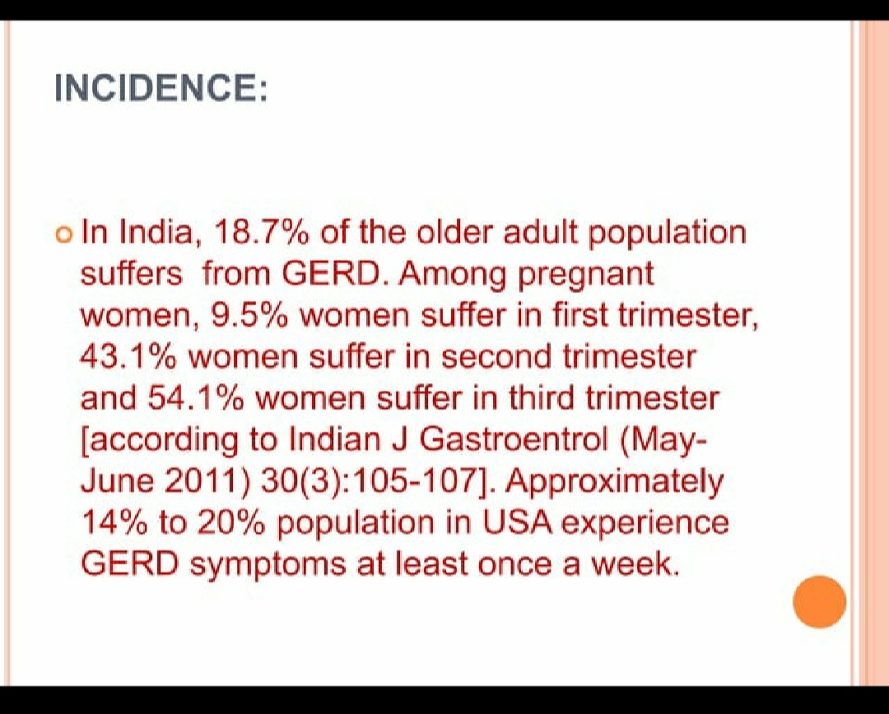

Slide 5
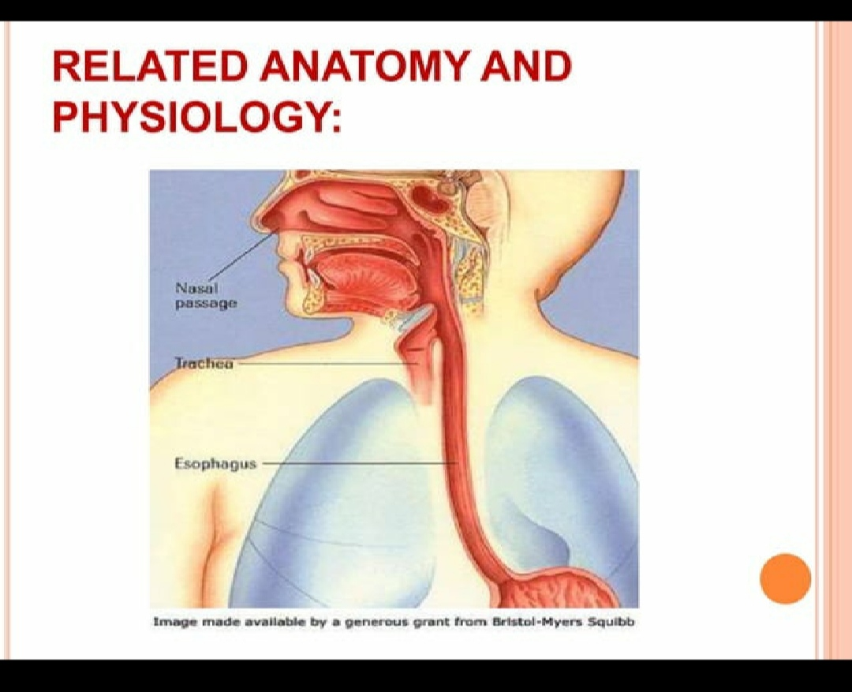

Slide 6
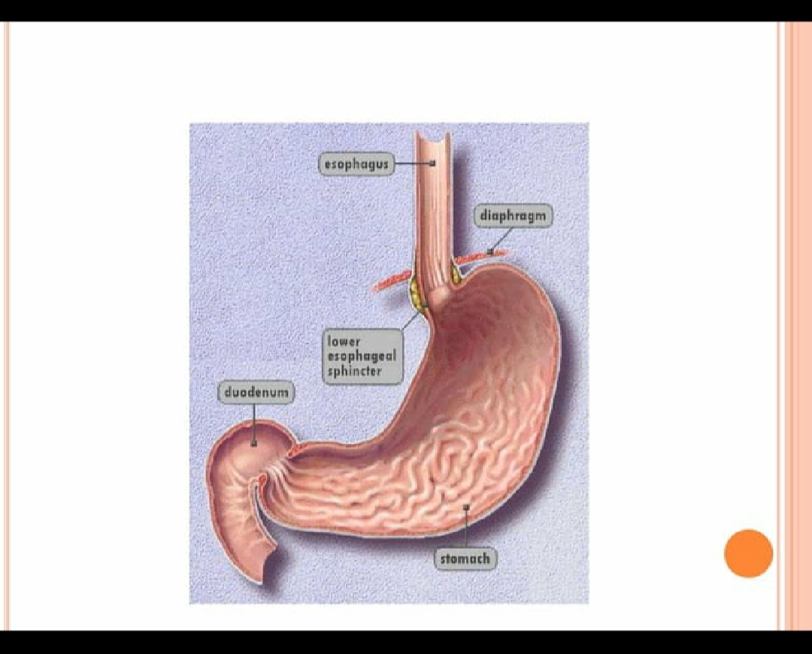

Slide 7
RISK FACTORS
DIET: caffeine,fatty/spicy foods,chocolate,coffee,peppermint,citrus,alcohol
Position & activity
Bending ,straining
External pressure:pregnancy,tight clothing

Slide 8


Slide 9
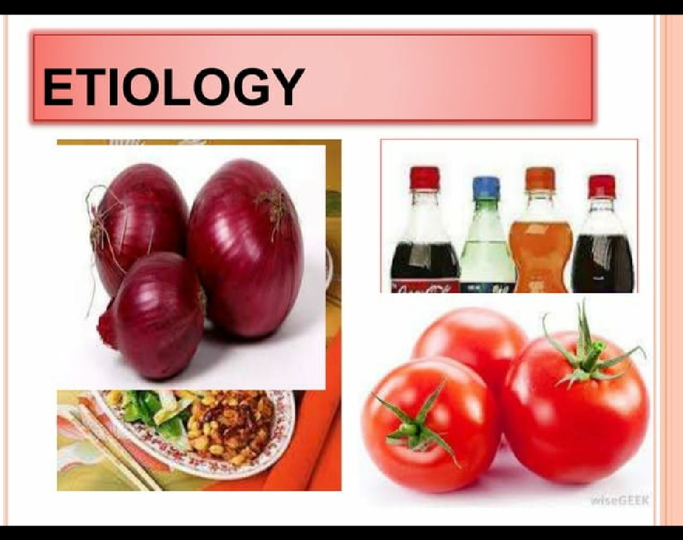

Slide 10
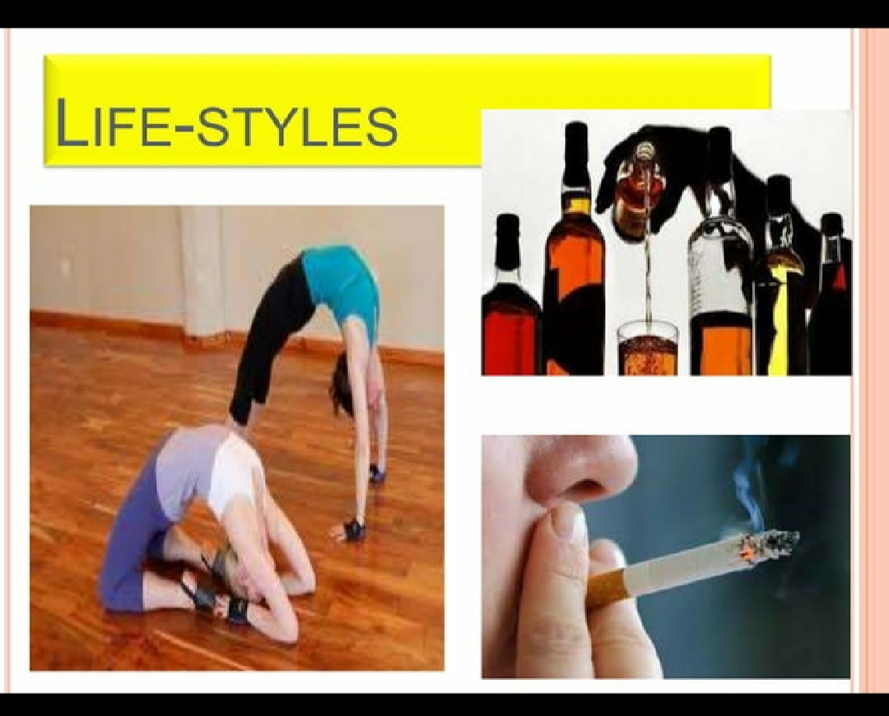

Slide 11
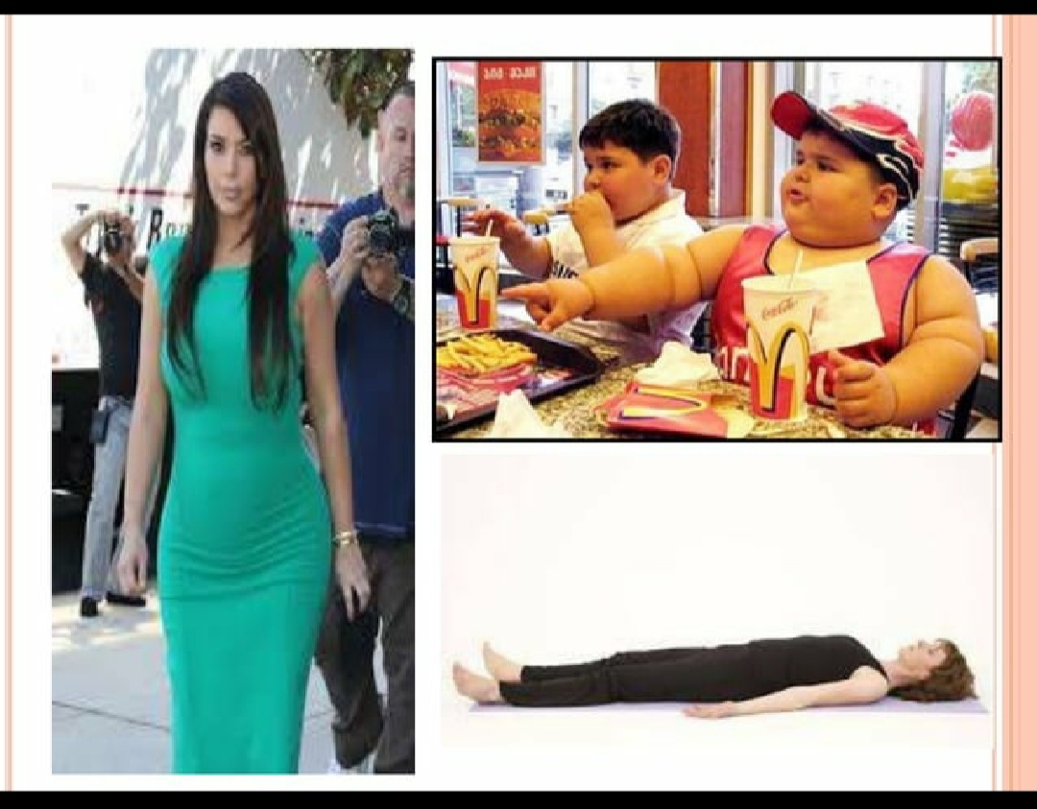

Slide 12
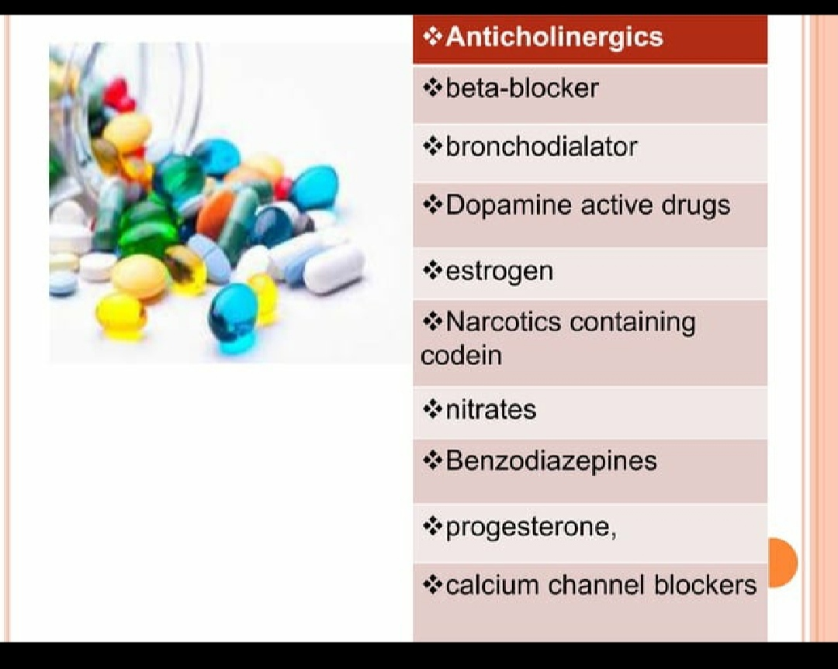

Slide 13
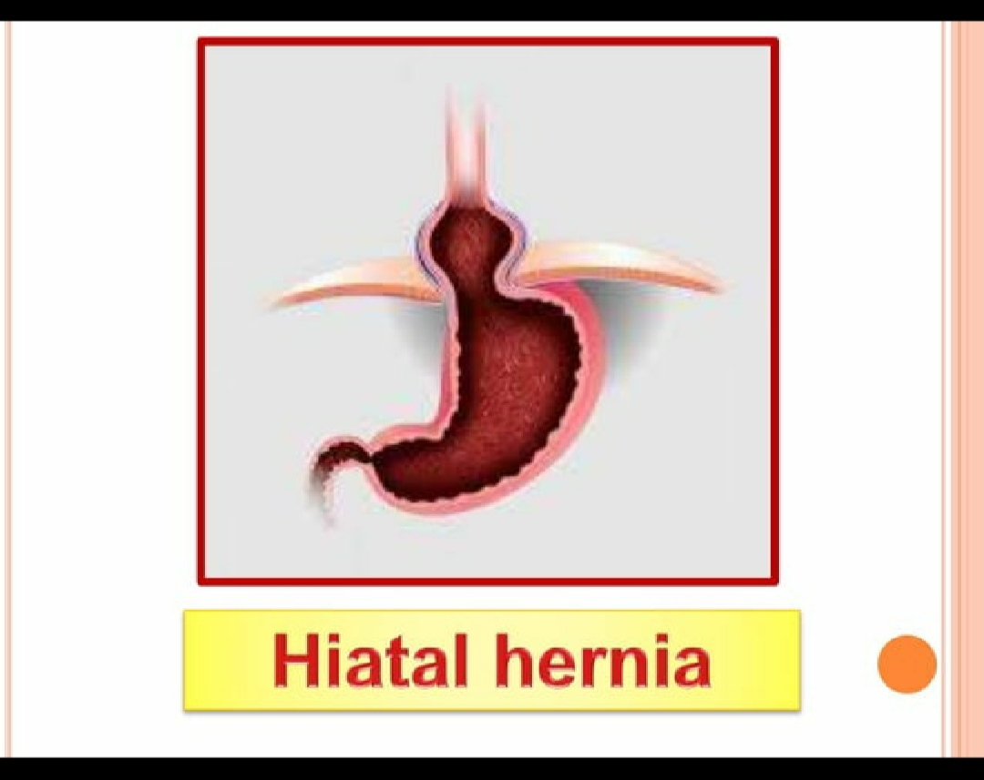

Slide 14
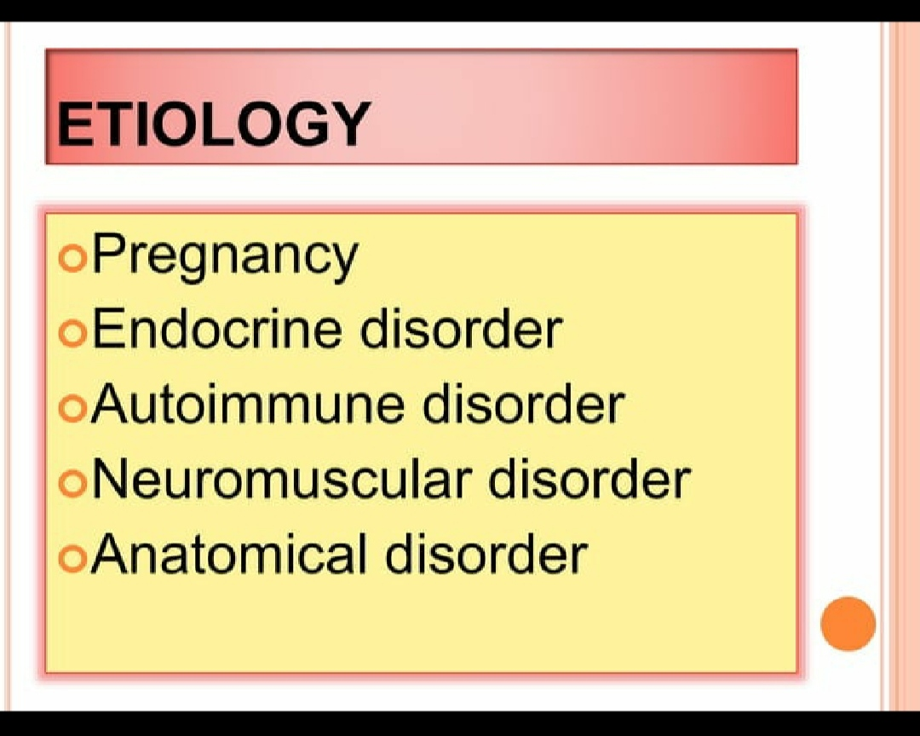

Slide 15
Etiology
Relaxation of the LES
Exact cause is unknown
An alteration in the innervation of the pressure zone in the region of the gastro esophageal sphincter.
Displacement of the angle of the gastro esophageal junction
An incompetent LES

Slide 16
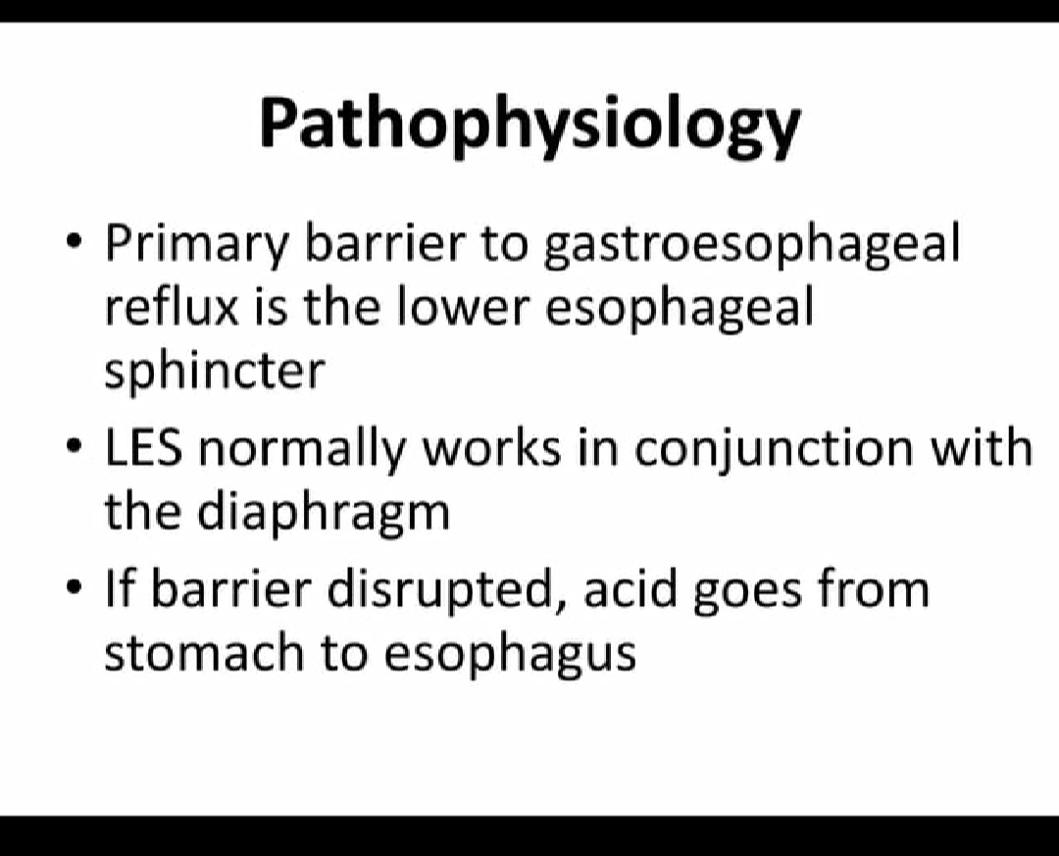

Slide 17
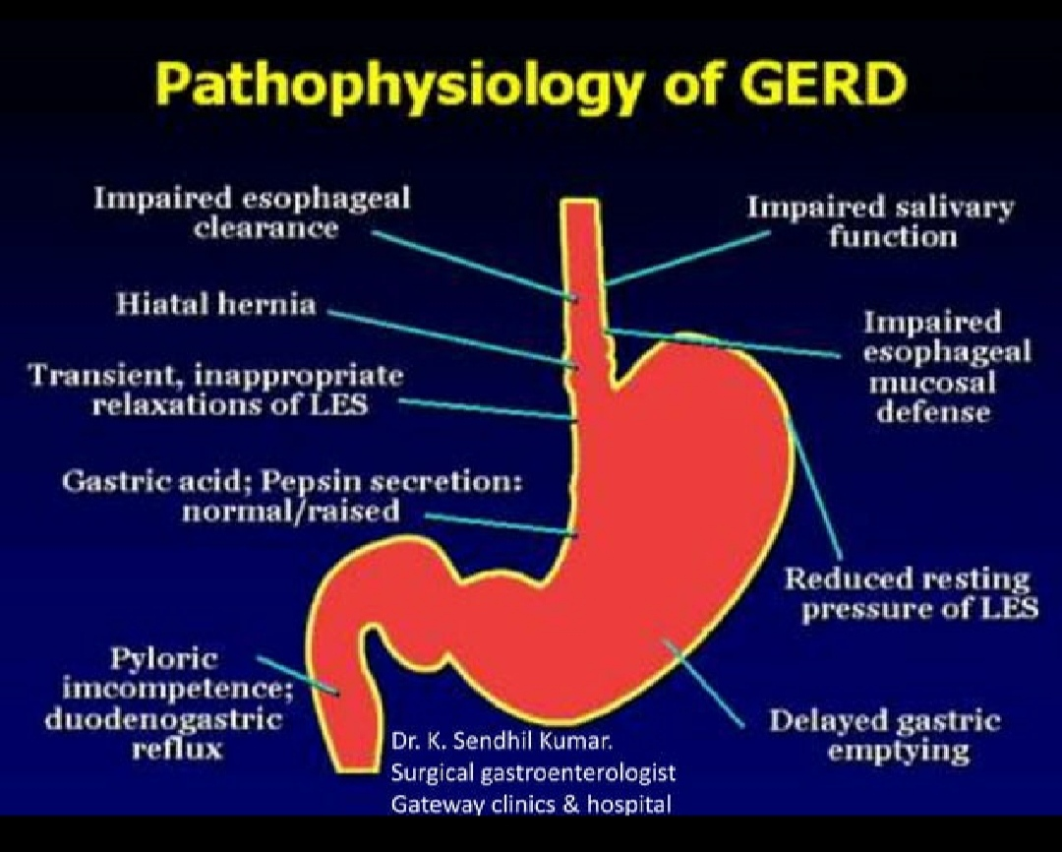

Slide 18
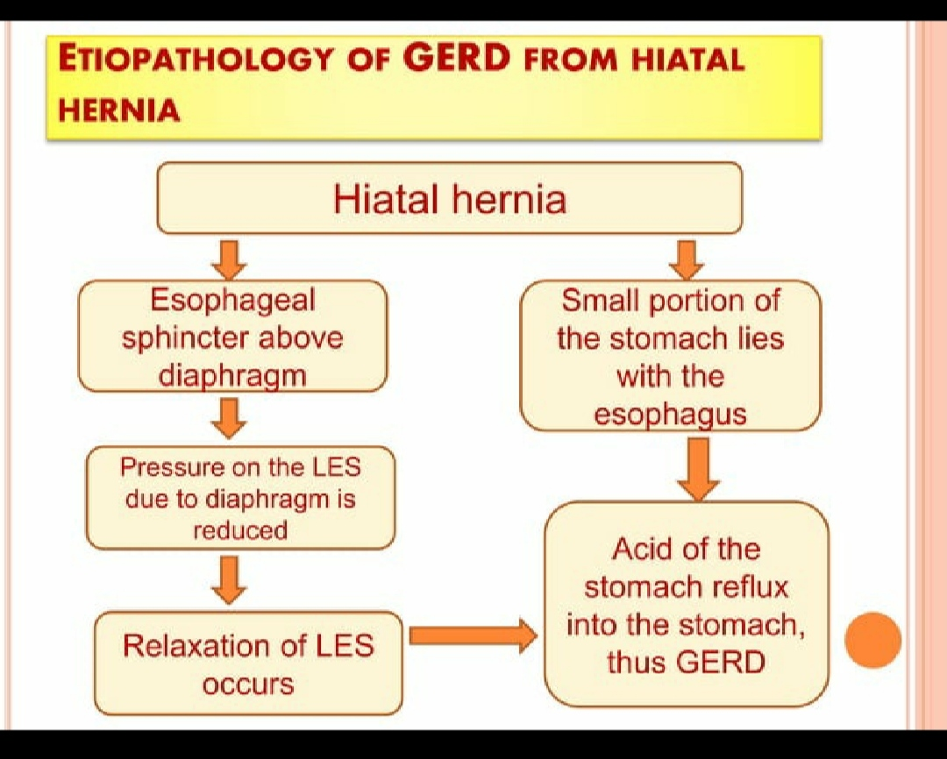

Slide 19
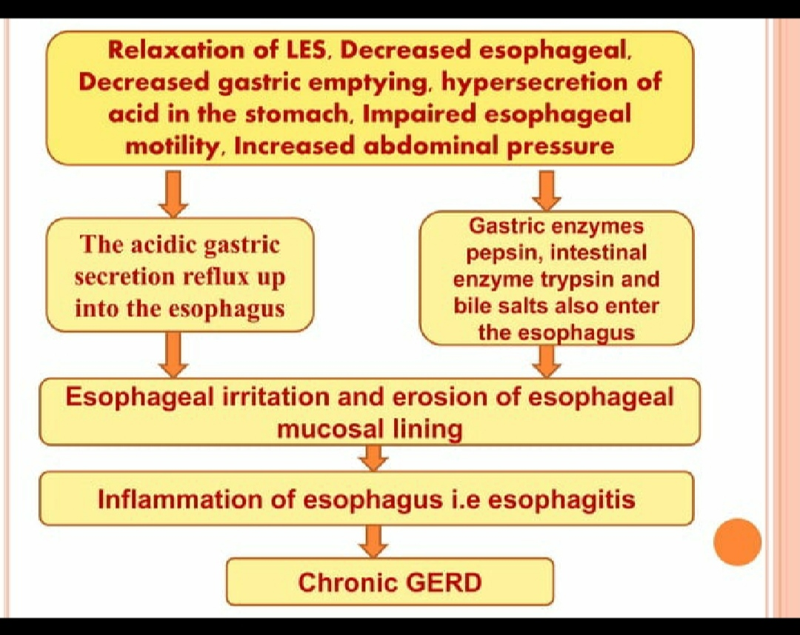

Slide 20
Alaming signs and symptoms
Dysphagia
Early satiety
GI bleeding
Odynophagia
Vomiting
Weight loss
Iron deficiency anemia

Slide 21
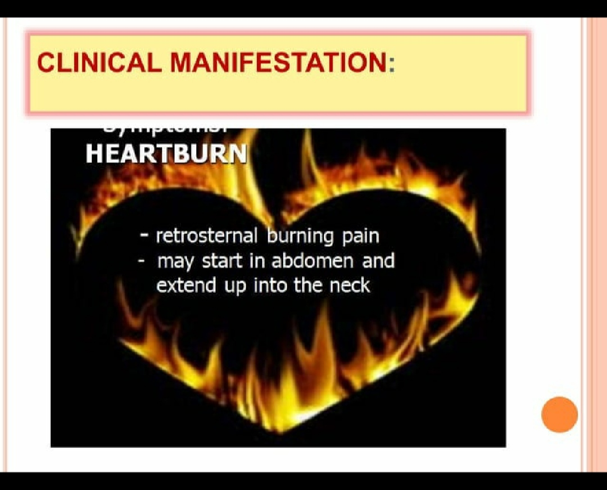

Slide 22
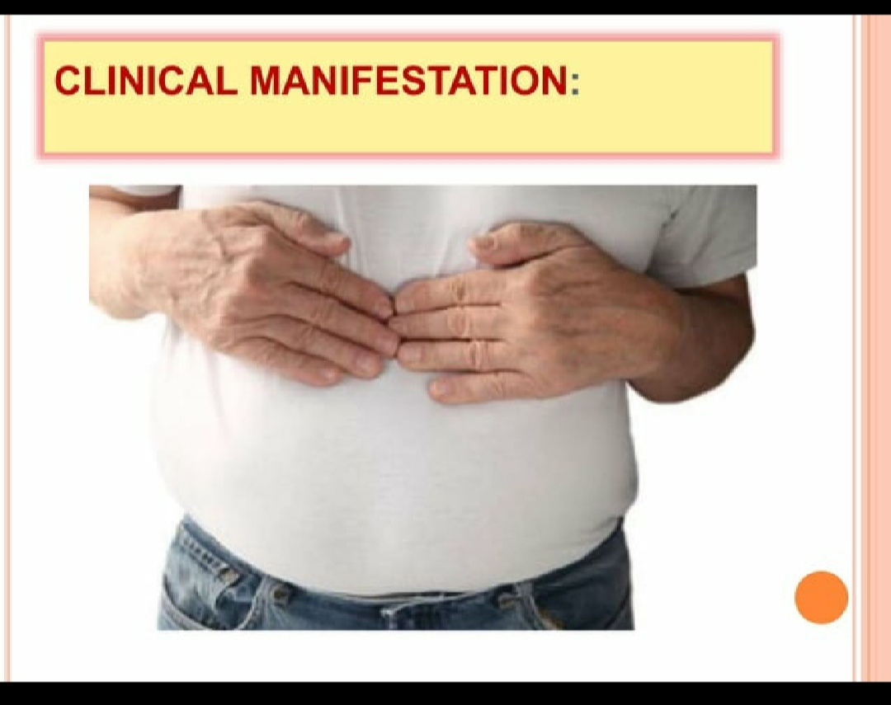

Slide 23
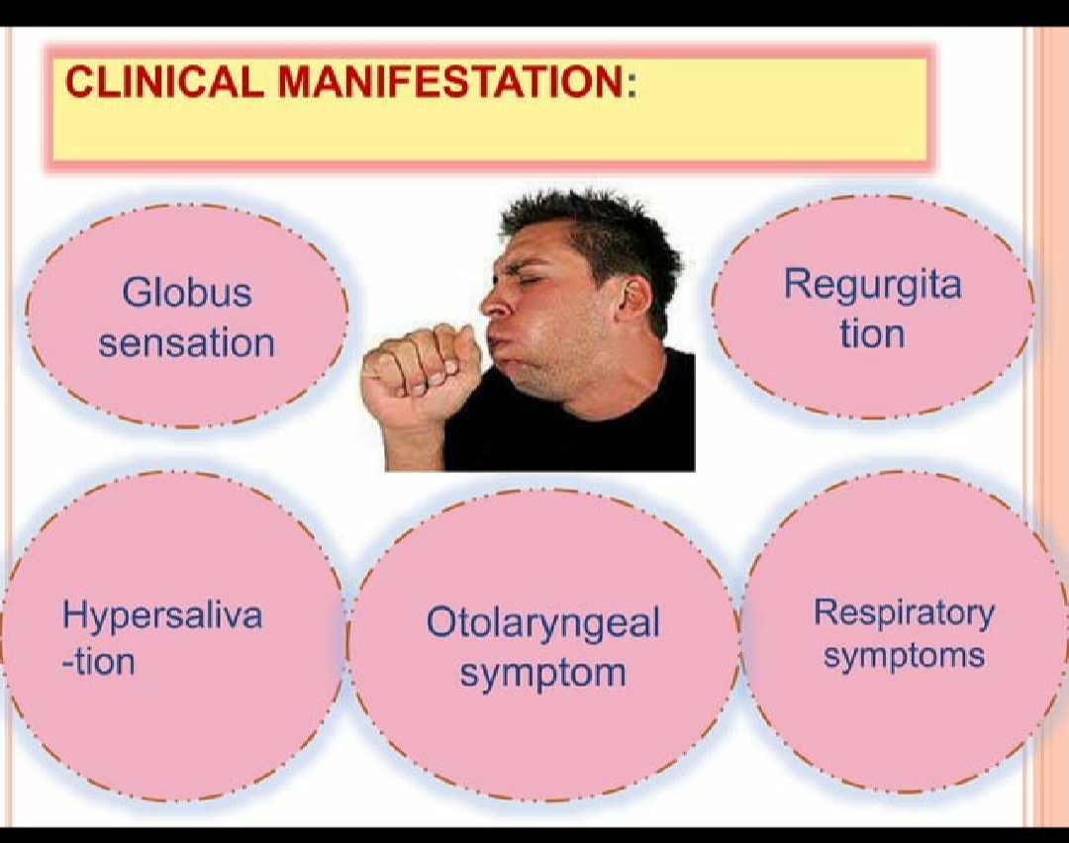

Slide 24
Globus sensation:
The sensation of having a lump or something stuck in the throt

Slide 25
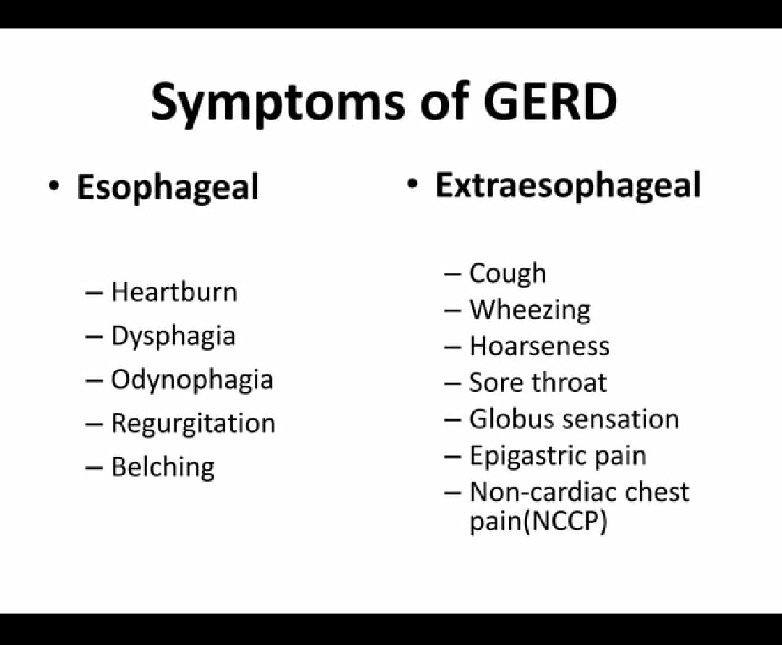

Slide 26
CLINICAL FEATURES
Pain usually occurs after meals and relieved with antacids or fluids
Discomfort during activities that increases intra abdominal pressure-lifting, straining etc
when lying supine or when the stomach is distended
standing or walking relieve discomfort
dysphagia resulting from edema, spasm

Slide 27
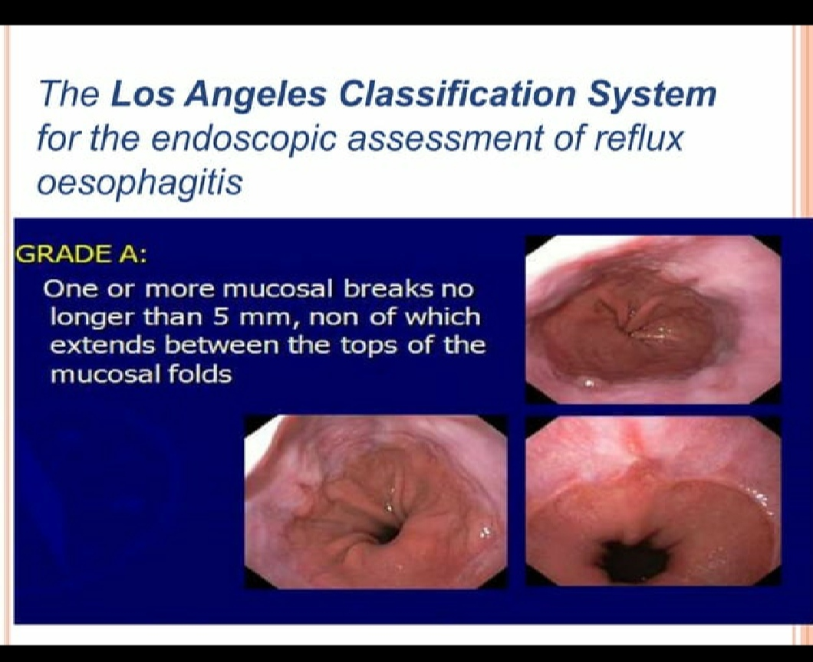

Slide 28
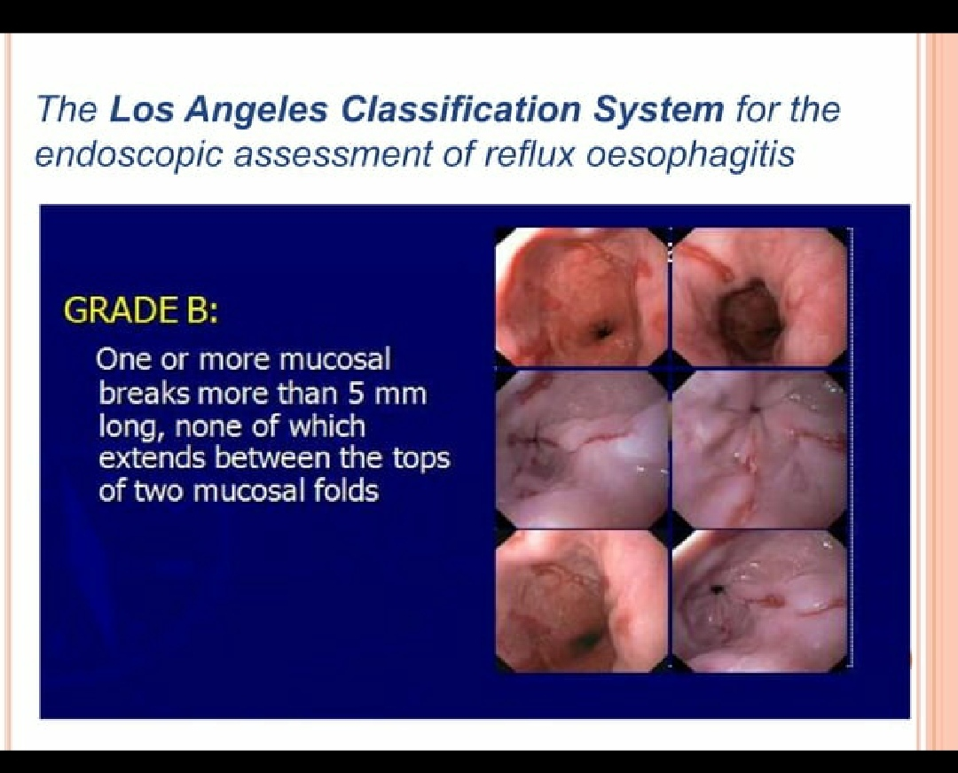

Slide 29
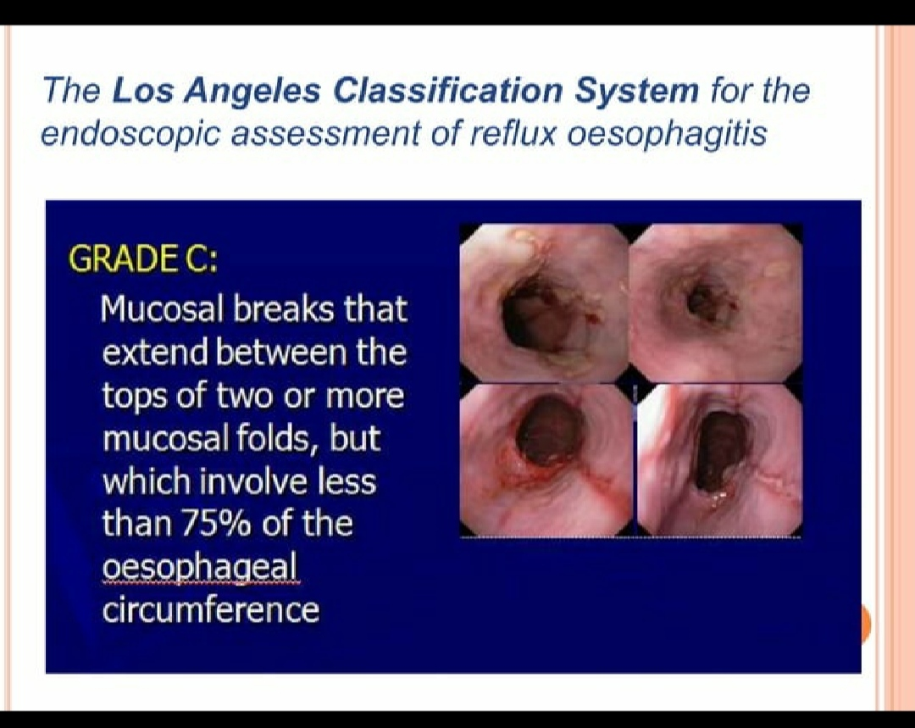

Slide 30
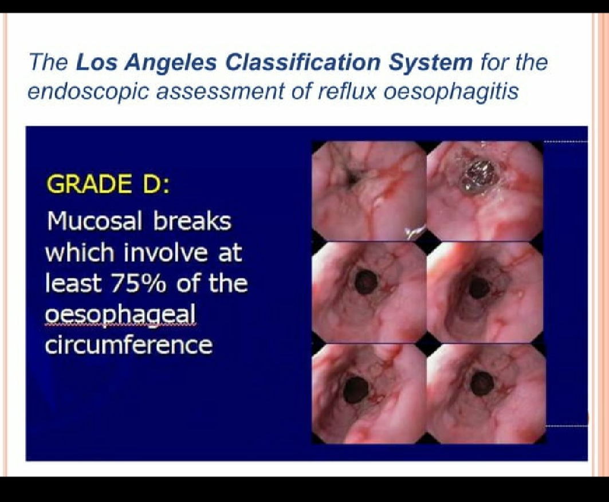

Slide 31
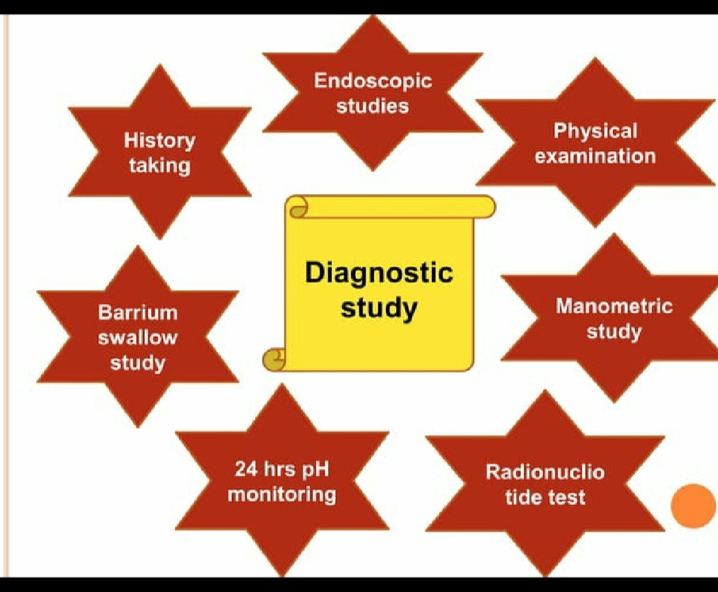

Slide 32
Manometric study
An esophageal mobility study
Test to assess motor function of the upper esophageal spincter,esophageal body and lower esophageal body and lower esophageal sphincture

Slide 33
24 PH monitoring
It measures the amount of reflex (both acidic and non-acidic ) in esophagus during a 24 hour period.
Normal PH for the esophagus is close to 7.0
The test involves placing a catheter or a special device called a PH probe into esophagus.
The catheter or device will measure the acid level

Slide 34


Slide 35
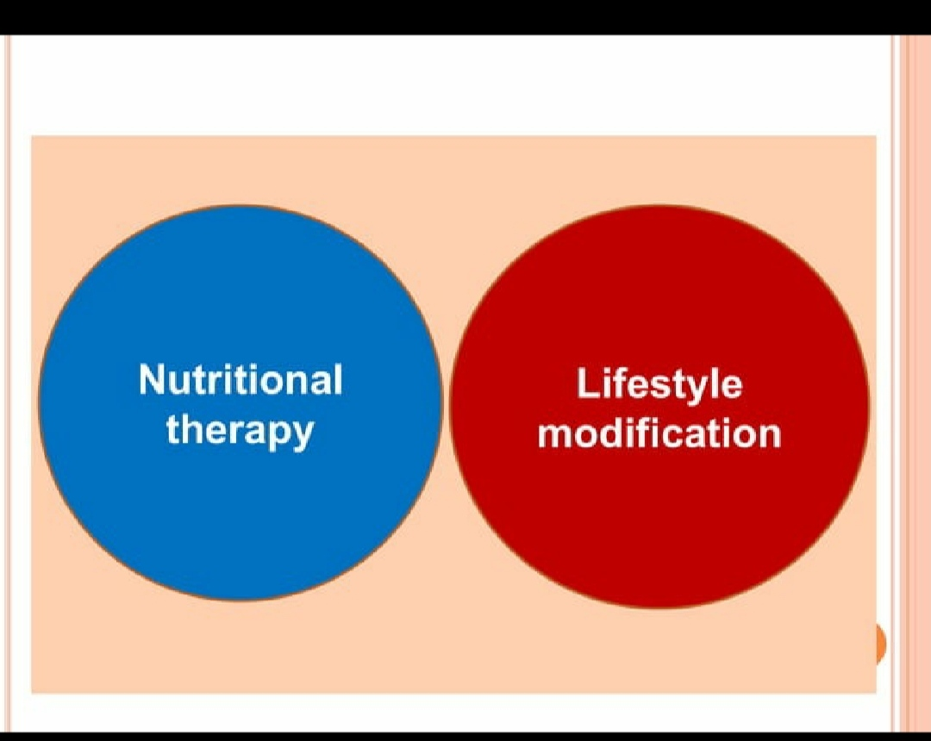

Slide 36
LIFESTYLE MODIFICATION
1.Weight reduction if overweight
2.Avoid clothing that is tight around the waist
3.Modify diet
eat more frequent smaller meals
Avoid fatty/fried food,peppermint,chocalate,alcohol,cofee and tea,onions
Stop smoking
4.Elevate head of bed 4-6 inches
5.Avoid eating within 2-3 hours of bettime.

Slide 37
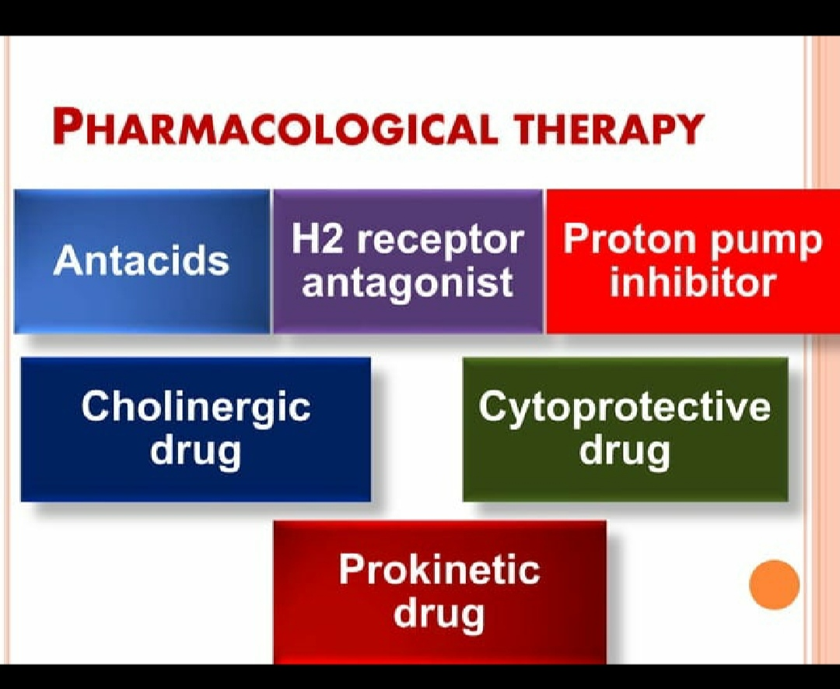

Slide 38
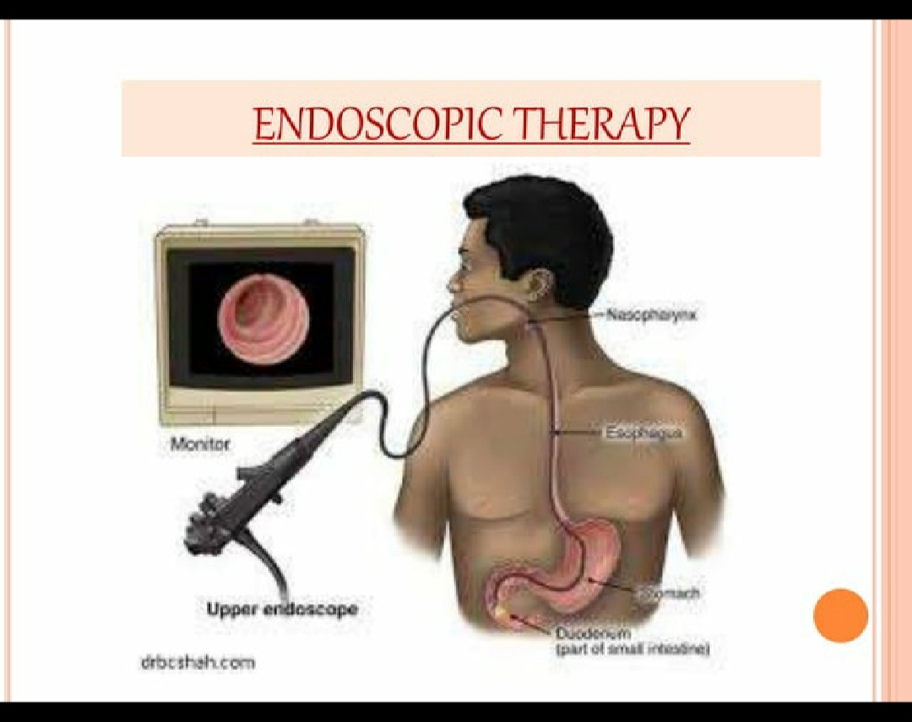

Slide 39
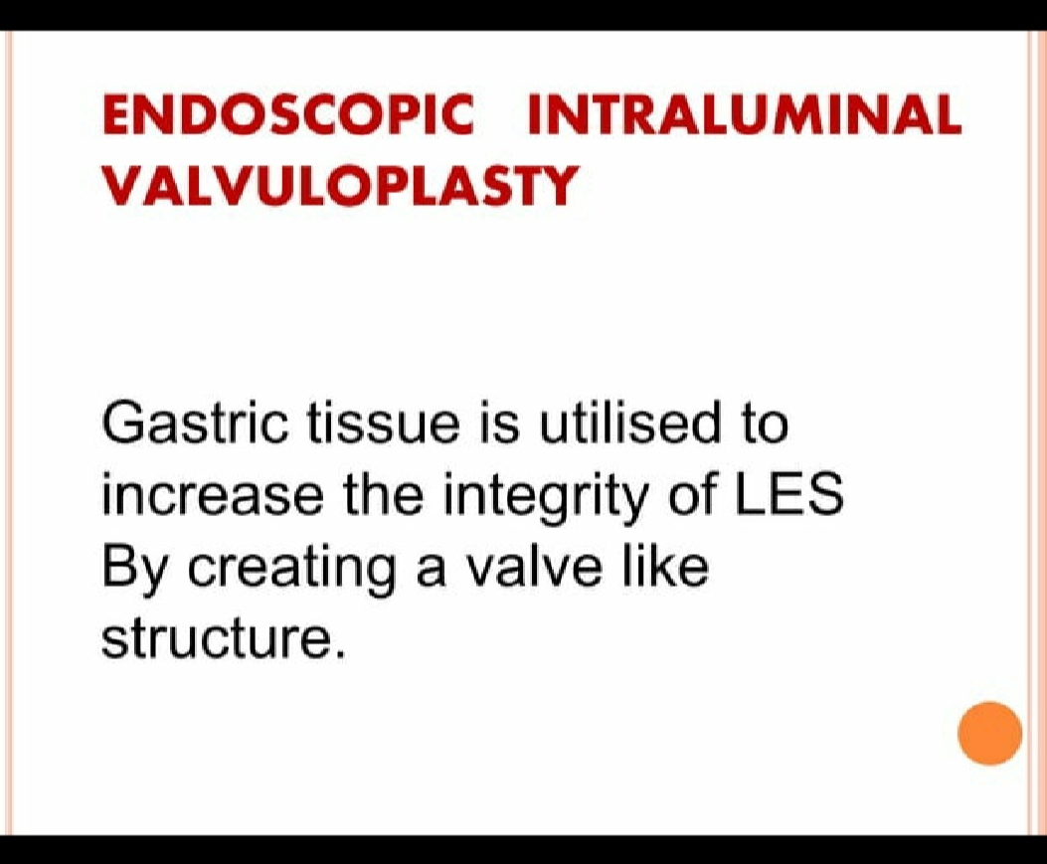

Slide 40
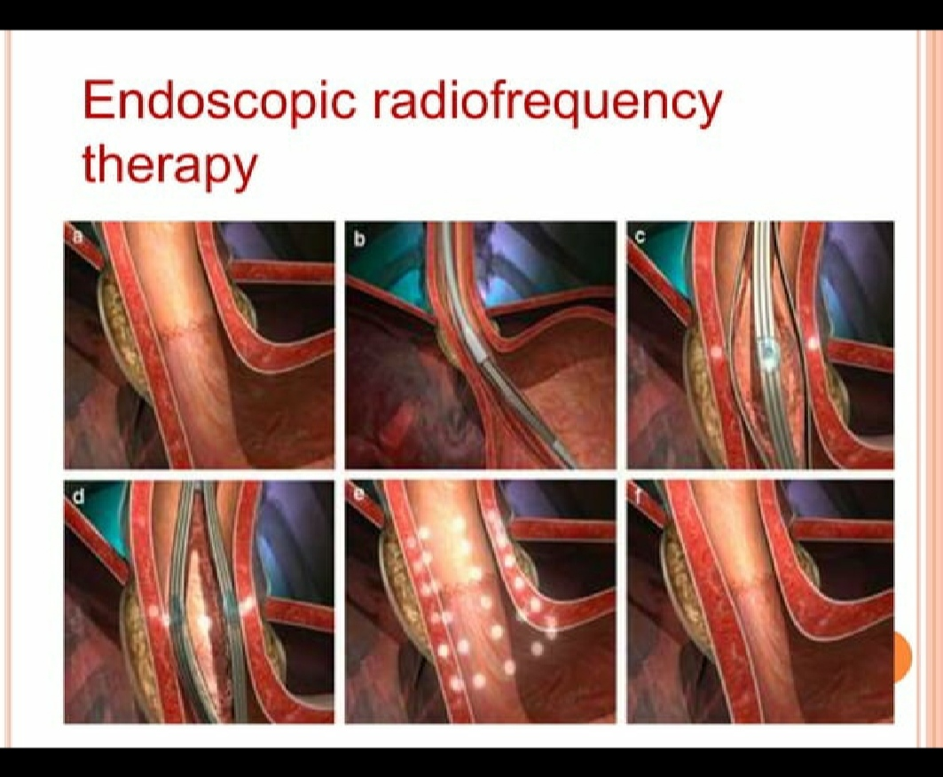

Slide 41
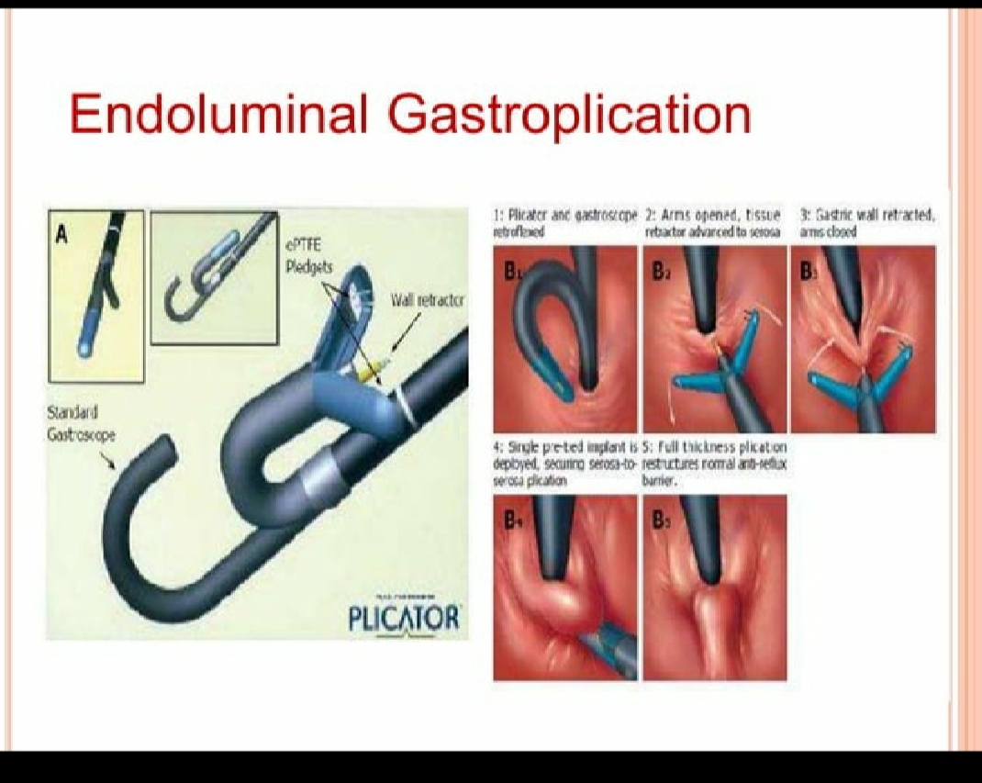

Slide 42
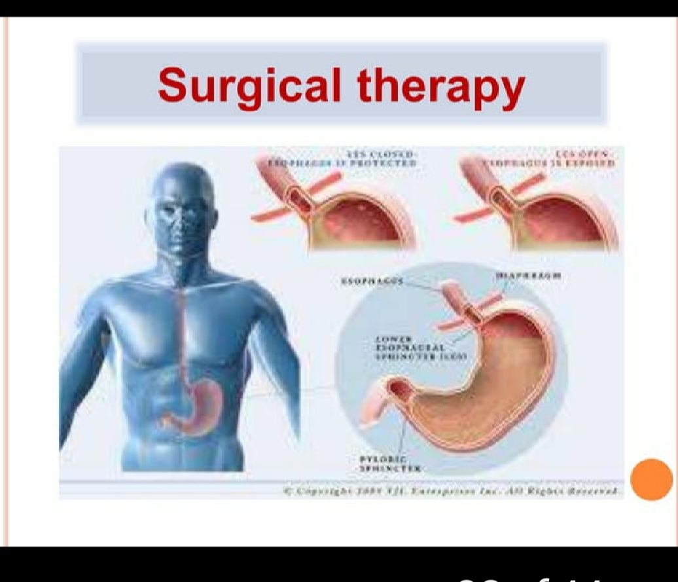

Slide 43
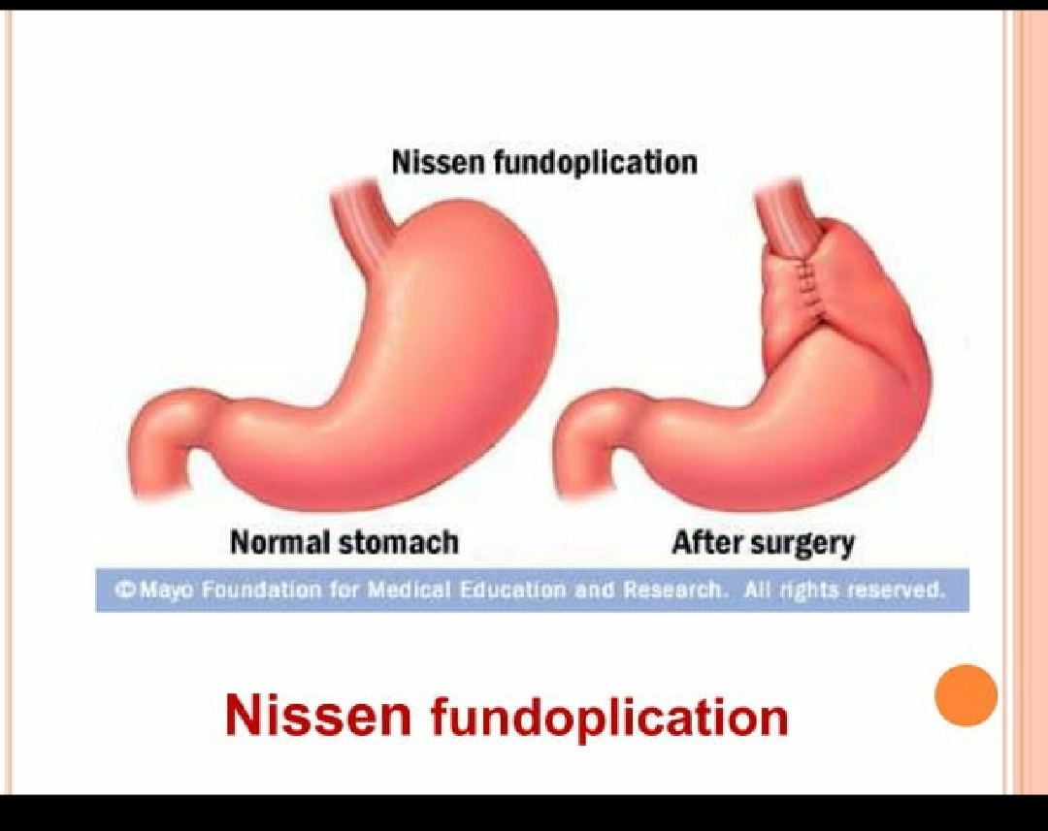

Slide 44
Fundoplication - wrapping of a portion of the gastric fundus around the spincter area)
can be performed by laproscopy

Slide 45
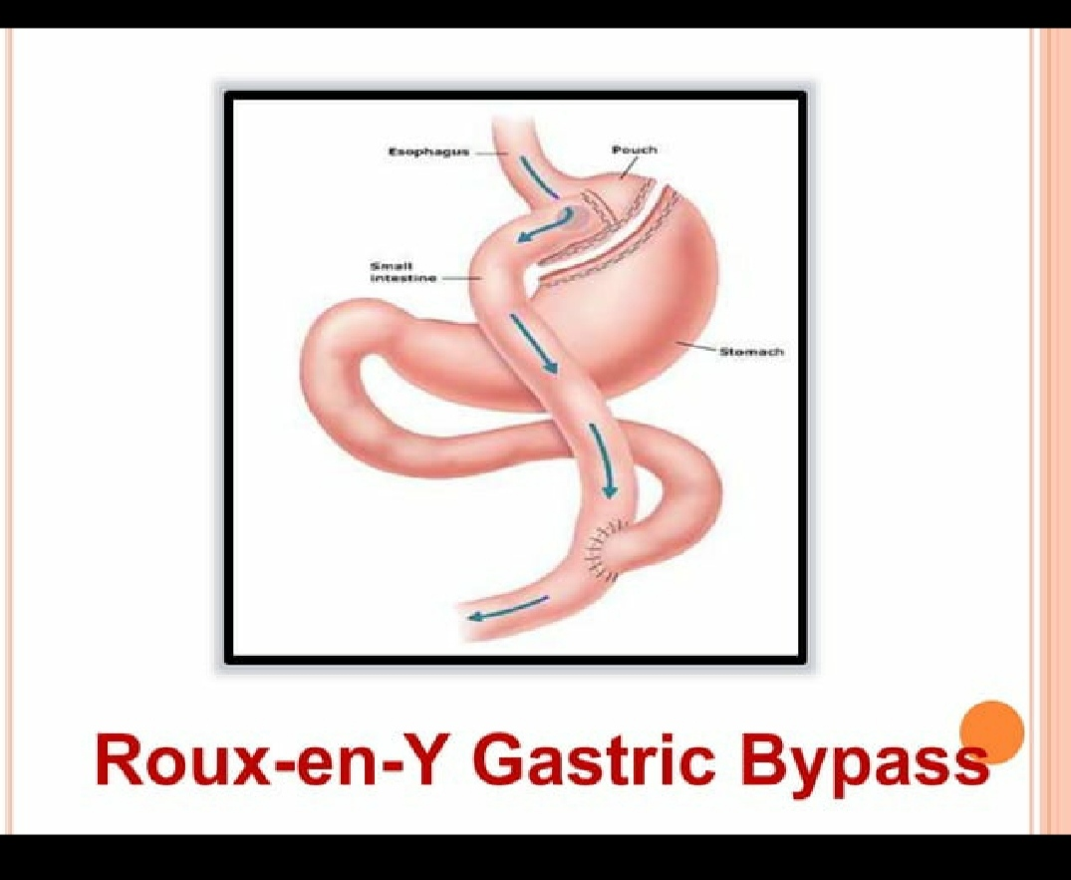

Slide 46
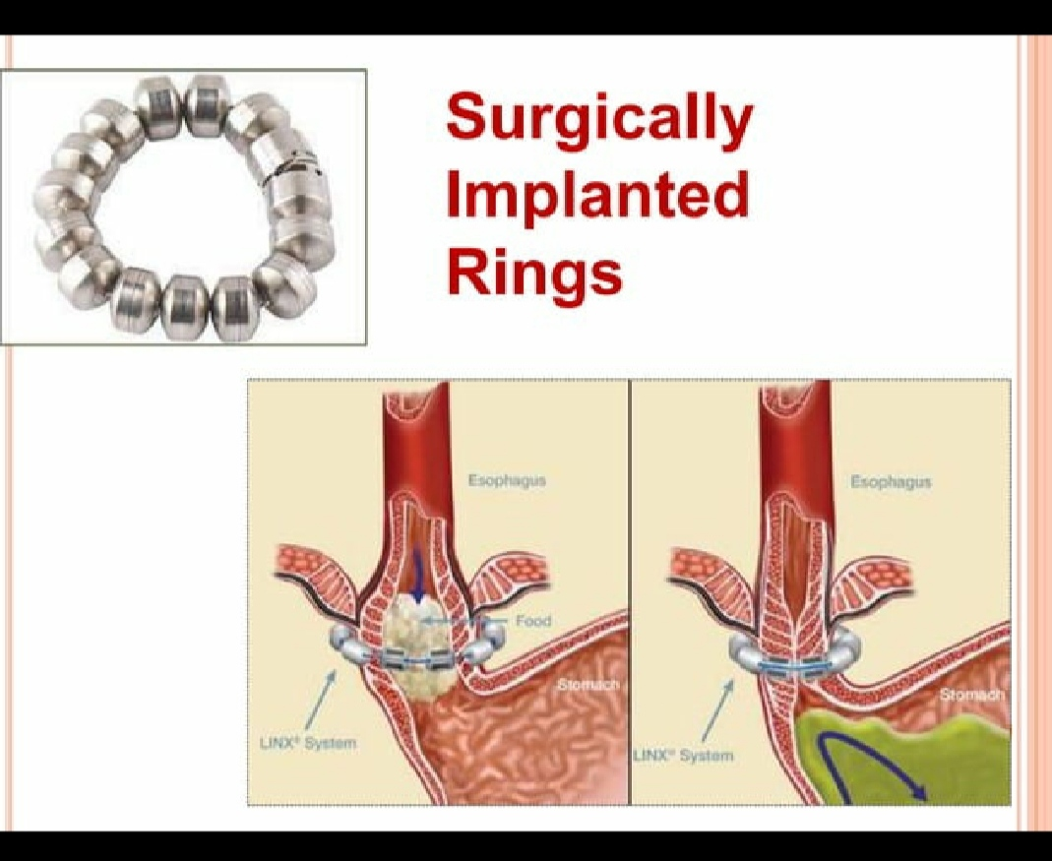

Slide 47
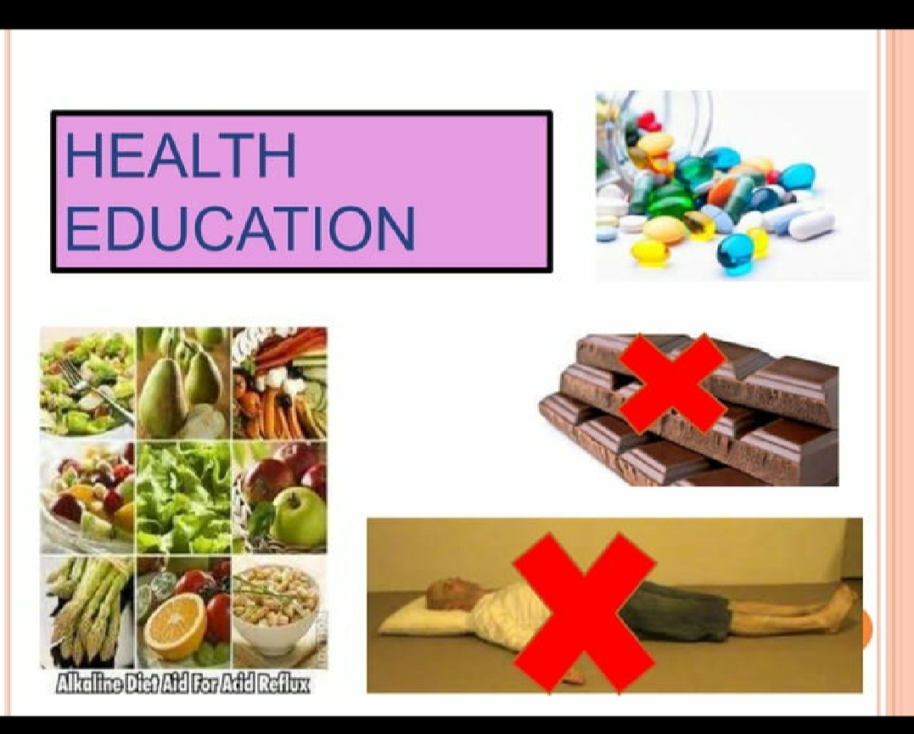

Slide 48
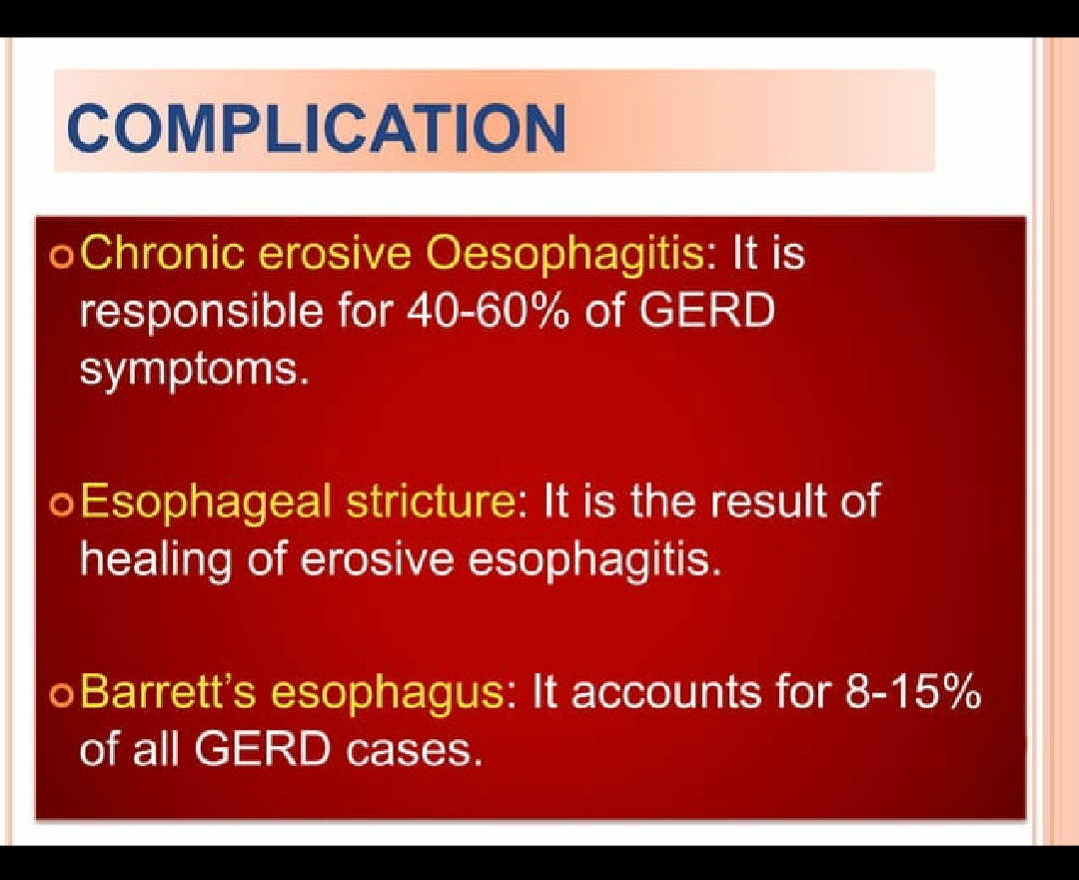

Slide 49
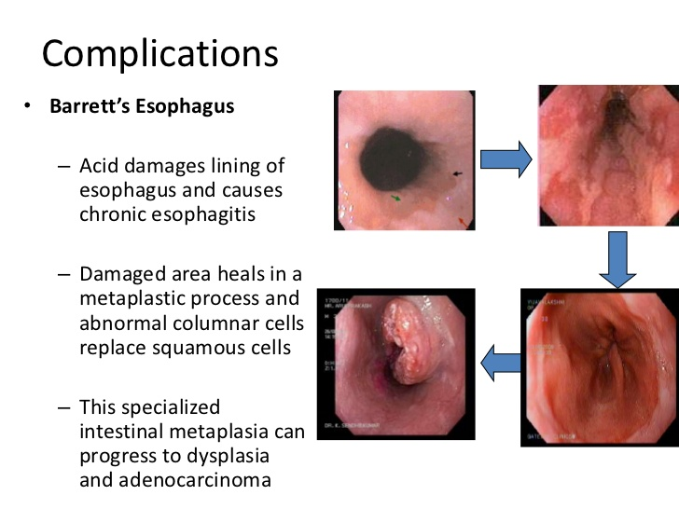

Slide 50
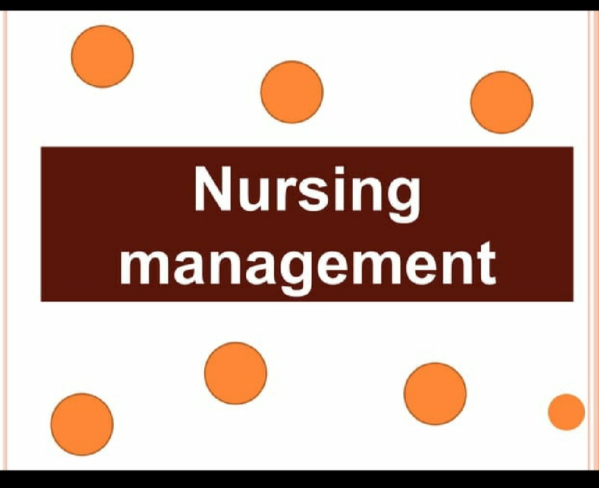

Slide 51
Acute pain at epigastric region related to reflux of the gastric contents into the esophagus
Nausea related to regurgitation delayed esophageal emptying
Imbalanced nutrition less than body requirement related to nausea inability to intake food adequately secondary to globus sensation in throat
Ineffective therapeutic regimen related to lack of knowledge of long term management of GERD lifestyle modification appropriate diet therapy

Slide 52
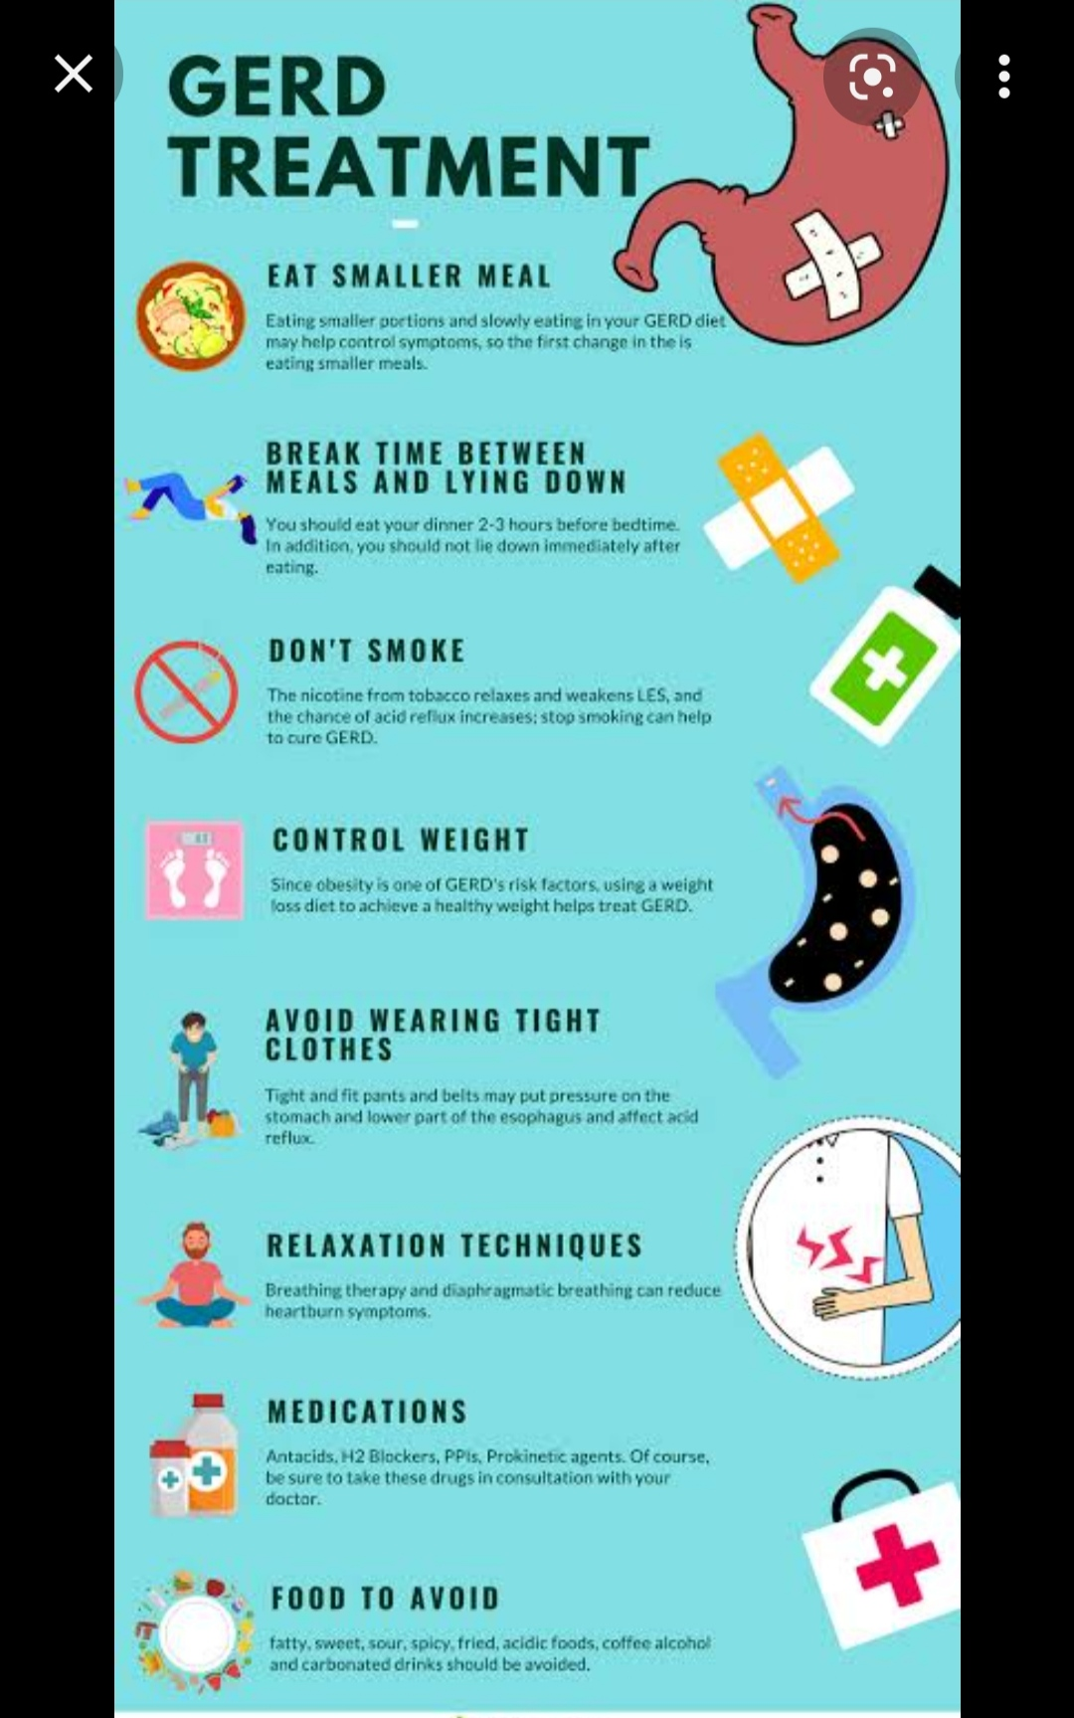

Slide 53
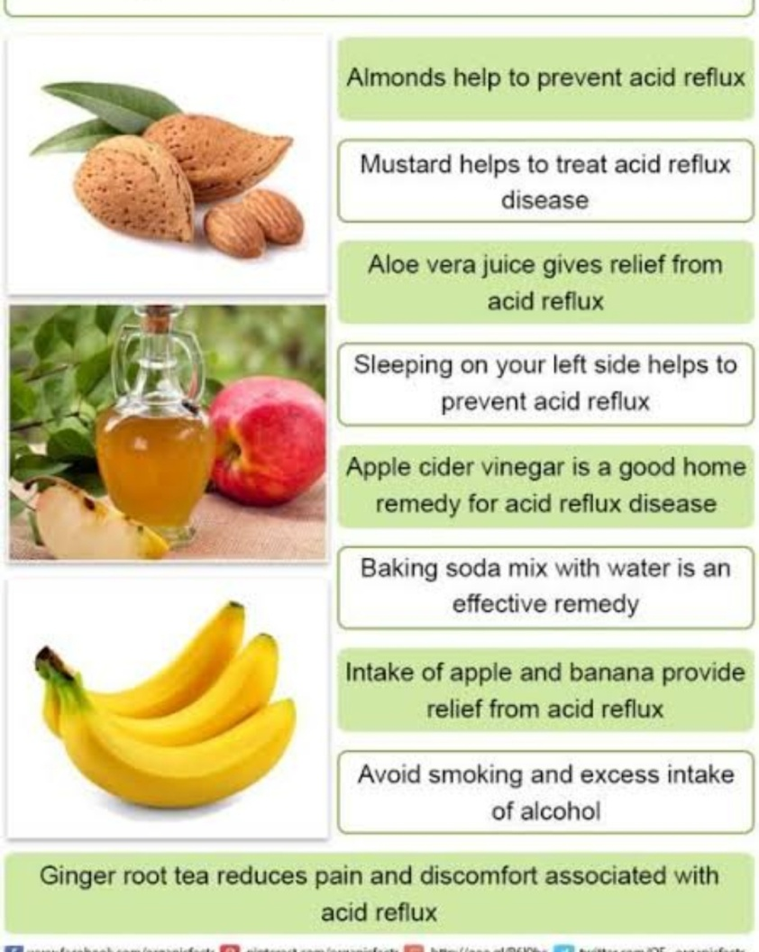
HOME REMADY

Slide 54
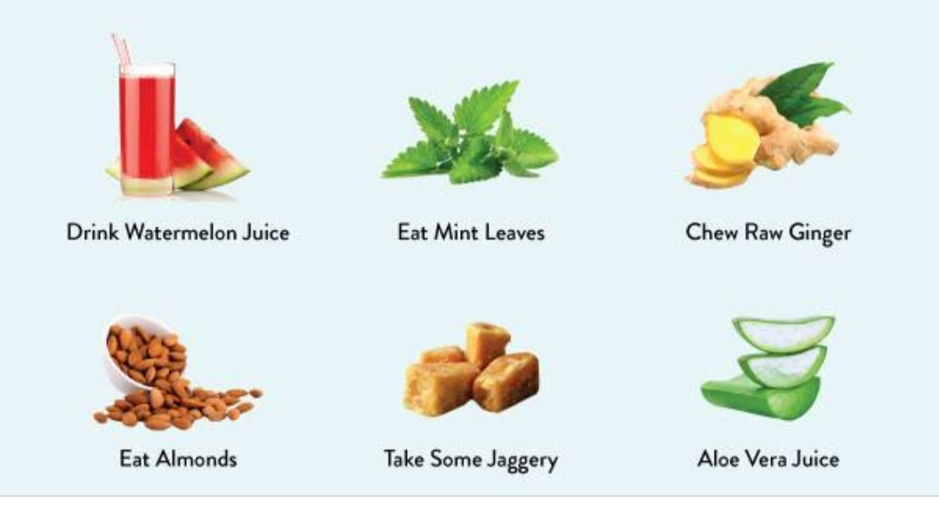

Slide 55


